Slide 1

Healthcare Chatbot with Personality
By Daniel Evans, Jim Huynh, Rohan Ashraf Hashmi, Alexander Robinson.
Course: CS-5530

Slide 2
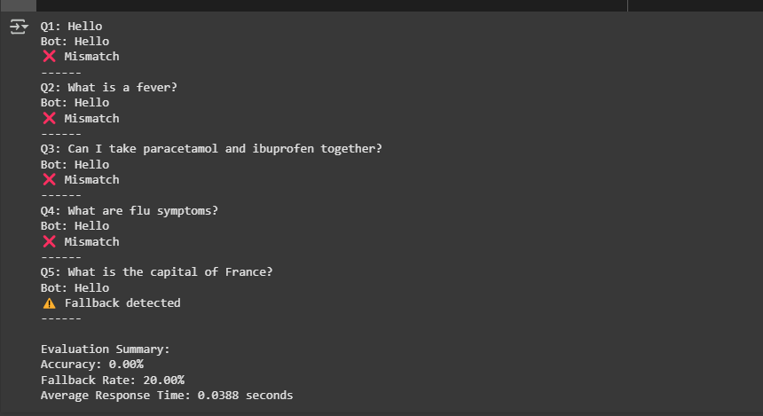
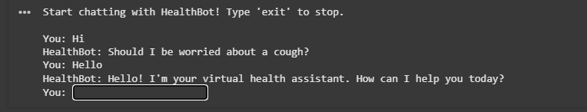
ChatterBot Attempt
Setup Simplicity
Key Limitations
Used logic adapters for basic conversation flow.
No context awareness or memory
Poor and irrelevant responses
Unsupported on latest Python versions
Bad Chatbot Example (ChatterBot)
Responses lacked specificity and usefulness for healthcare needs.

Slide 3
General Chatbot Training Attempt
(Rohan)
What i did:
Why It Didn’t Work
Used 4 .parquet files from the Cosmopedia (web_samples_v1) dataset.
Tokenized the text using nltk and created a word-to-index vocabulary.
Built a custom Transformer decoder model (MiniTransformer) in PyTorch.
Trained the model from scratch using:
Dialog-like text samples
Cross-entropy loss and Adam optimizer
Planned to fine-tune the model for healthcare use cases later
Dataset wasn’t conversational
Cosmopedia samples were mostly info-paragraphs, not user-bot dialog
No clear structure for intent or reply
Couldn’t train the model to classify or generate meaningful responses
Model too small and undertrained
MiniTransformer lacked the capacity for real-world dialog understanding
No evaluation or validation logic
Couldn't measure how well the model was doing or tune it effectively
No spell correction or preprocessing pipeline
Real-world user input wasn’t handled (typos, case, punctuation)

Slide 4
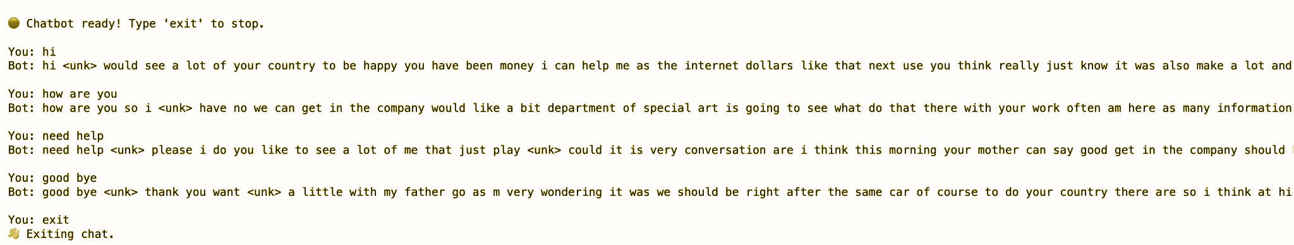
Sample Chatbot Interaction
(Rohan)
What You See:
Why This Happened:
Responses are mostly nonsensical, repetitive, or contain <unk> tokens
Bot uses random phrases that don’t relate to user input
Shows lack of understanding, coherence, or intent mapping
Model wasn’t trained on structured dialogs
Too small, undertrained, and used a generic dataset
No cleaning or token filtering → results in <unk> (unknown) tokens
No response logic or fallback mechanism for unknown queries

Slide 5
Intent Classifier to Support GPT-2 Chatbot
(Rohan)
Purpose:
Built a lightweight classifier to identify user intent before handing input to the GPT-2 chatbot
Aimed to improve the model’s understanding of user intent, especially for healthcare-related queries
The classifier was built as a support tool, not a primary response engine
What I Implemented:
Spelling correction using SymSpell and Levenshtein distance for noisy input
Semantic similarity scoring using Sentence-BERT embeddings and cosine_similarity
Optional fallback to TF-IDF similarity when embeddings are ambiguous
Robust preprocessing: lowercasing, punctuation cleaning, and filtering
Matched user queries to predefined patterns in intent.json

Slide 6
Custom Dataset for Healthcare Chatbot
(Rohan)
What I Did (used to finetune the model):
Designed a detailed intent-based dataset tailored for hospital settings
Included:
25+ intent tags (e.g., appointment_booking, billing_status)
1000+ realistic user patterns with casual phrasing
Multiple personality-rich responses (e.g., with emojis 😊📅💊)
Context-based follow-ups for smooth multi-turn conversations
AI Tools I Used
Leveraged ChatGPT and Grok (xAI) to:
Generate diverse query patterns for each intent
Draft expressive, human-like responses
Brainstorm edge cases and follow-up scenarios

Slide 7
Dataset Generation
with ChatGPT (Daniel)
Prompt engineering (1): Using the given intents.json as an example, use ChatGPT-4o to generate a prompt to start generating data
LLM Prompt (1): Feed the generated prompt to ChatGPT-o3 generate a skeleton intents.json file (generate only tags and contexts)
Python (1): Separate the received intents into batches to help the LLM focus on data generation
Prompt engineering (2): Use ChatGPT-4o to generate a prompt to generate some patterns and responses
LLM Prompt (2): Feed that prompt with each batch to ChatGPT-o3 to generate data
Prompt engineering (3): Use ChatGPT-4o to generate a prompt to generate more patterns/responses
LLM Prompt (3): Feed that prompt with each batch to ChatGPT-o3 to expand on each batch of data
Python (2): Recombine all the batches into a unified .json
Python (3): Replace special characters (like non-breaking space/hyphen, em-dashes, accented vowels) with simple counterparts
All interaction with the LLM was “manual”, via the web interface (no API)
User-specific LLM ‘memories’ and ‘custom instructions’ affect output – it did have memories referencing the chatbot, but I did not supply any custom instructions
Using multiple prompts (steps) and batching yielded usable results, while prompts that were too ambitious yielded lots of templates instead of utterances (eg, “Request nurse response variation #53” instead of an actual variation)

Slide 8
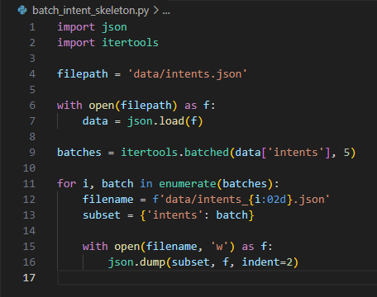
Dataset Generation
with ChatGPT (Daniel)
Link to documentation to prompt for intent skeleton
“I'm making a public-facing chatbot for a nurse's station, which is intended to help patients and visitors find information and resources. I need an LLM to generate a dataset to train the chatbot. I will give you an intents.json as an example of the format for the dataset. Help me construct a prompt, which will instruct the LLM to create to create single- and multi-step intents for this purpose.”
Batch out the intent skeleton ▶

Slide 9
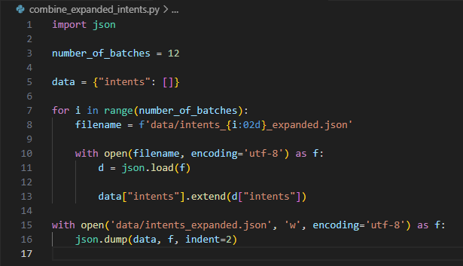
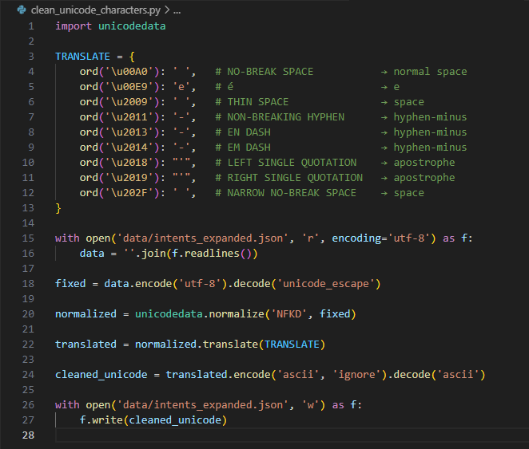
Dataset Generation
with ChatGPT (Daniel)
Link to documentation for filling intents
Link to documentation for expanding intents
Combine the expanded batches ▶
◀ Clean/normalize accents, punctuation, and whitespace

Slide 10
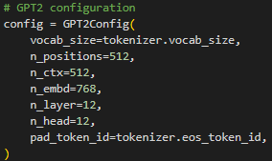
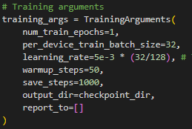
GPT-2
We chose the pretrained GPT-2 tokenizer so that we don’t have to train our own tokenizer from scratch. The GPT2 tokenizer has been proven to work so we decided to use that.
We used the GPT-2 head model which keeps the architecture of the GPT-2 model, but randomly initializes the weights, so we train from scratch.
For training we only trained for roughly 0.5 epochs total because there was over 6 million different conversations and we trained for ~80 hours.

Slide 11

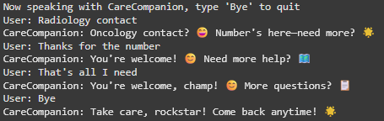

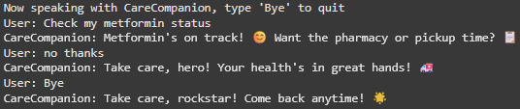
GPT-2 Sample Conversations
Simple conversation
Multi-turn conversation
Simple conversation with potential function lookup
Another sample conversation

Slide 12
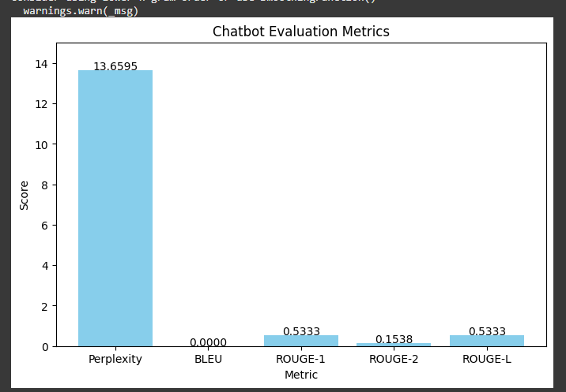
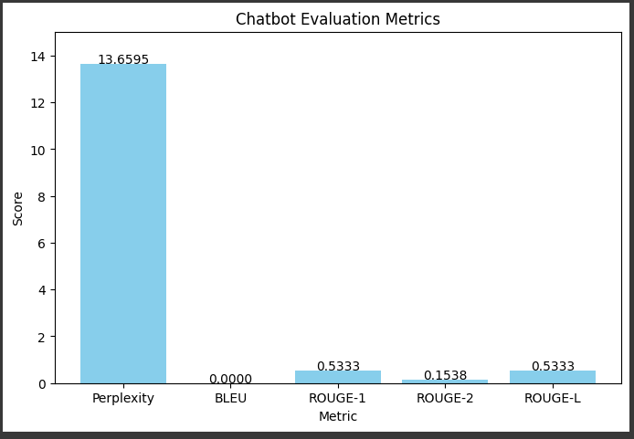
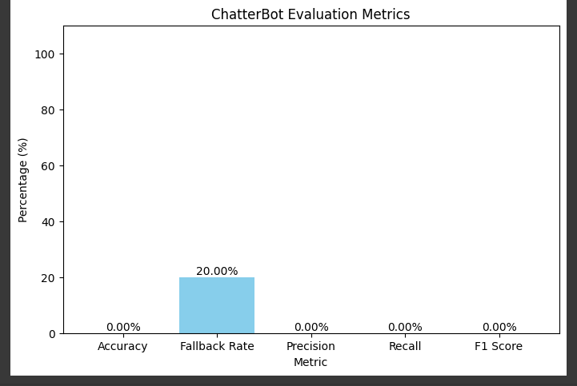
GPT-2 Evaluation
Fine tuned model
Final Model
Chatterbot

